Slide 1
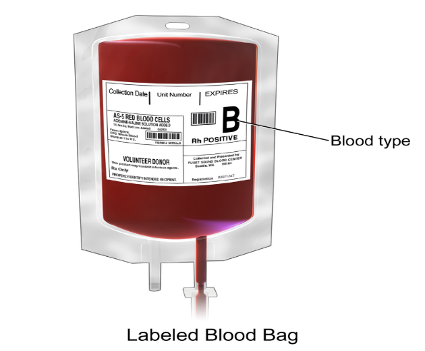
RFID Based Blood packet Tracking Application

Slide 2
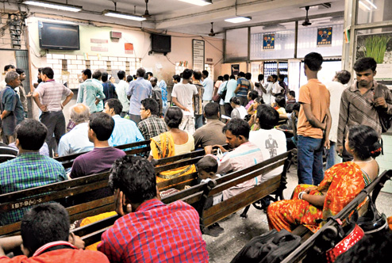
Customer: Central Blood Bank Kolkata
Software Partner: Albatross

Slide 3
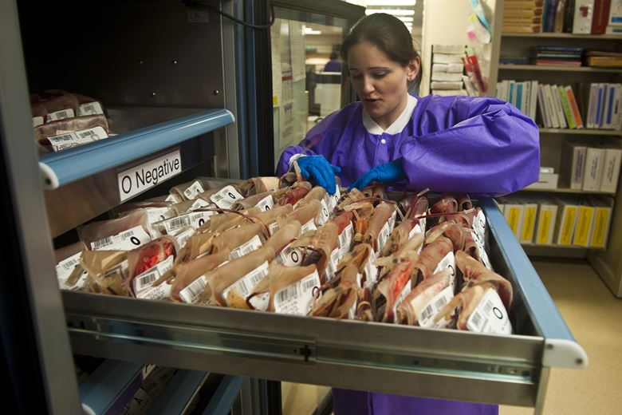
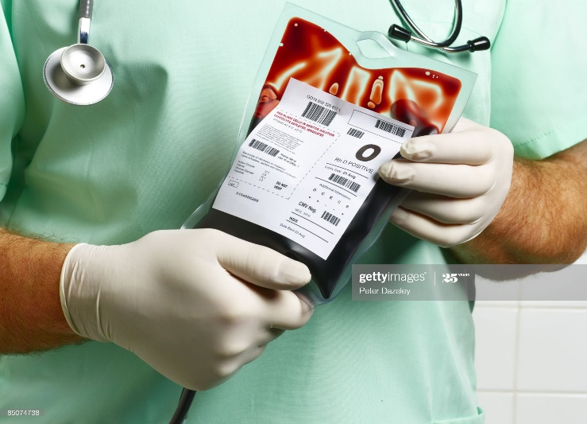

Blood Bank Present Manual workflow
Blood collection is one of the challenges of Blood Banks, which aims at providing products produced from blood to hospitals. These organizations face the challenge of meeting supply and demand of blood products. Every Blood bank need a system to manage inventory levels of blood products in Blood Banks to direct blood collection campaigns. The idea of the system is to maximize the offer and minimize the waste caused by products’ expiry dates
Whole blood can be stored for 35 days. The various blood components can be stored as under;* Platelet Concentrate - 5 days* Packed Cells - 42 days*Fresh Frozen Plasma – 1 year* Cryo Anti Haemophilic Factor – 1 year Deep Freezer (-40°C and -80°C) are used to preserve plasma, related blood components while platelets are store in agitator machine at 20°C for proper storage.

Slide 4
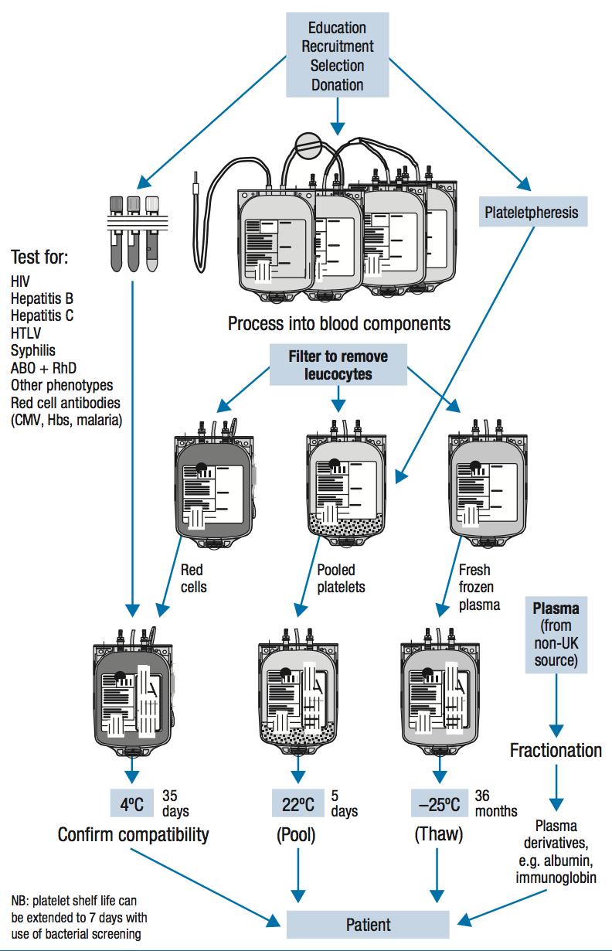
Process flow of Different Blood Component

Slide 5
Under the existing system, when patients require blood, their families have to stand in queues at hospital banks with requisition slips and blood samples. If the required units are not available in the hospital bank, they have to run from one facility to another. But once the system goes online, the application will go straight from the hospital’s ward to the hospital blood bank. If the unit is not available there, the application will be sent to other banks.
“Once the online requisition system starts, it will not only spare patients’ families the harassment but also rationalise blood supply. For example, if a patient needs 4 units of blood, the hospital bank can directly ask with the ward whether two units were enough for the moment and the remaining two could be sent later. This would prevent wastage of blood. Once the software is in place, an alert will be sent to the registered mobile number of the patients’ families about the availability of blood units.
One of the most significant benefits of utilizing RFID in transfusion services is the impact on positive patient identification by aiding in the elimination of human error. By utilizing RFID to identify recipients, the risk of misidentification of blood products and patients is significantly decreased.
Why Blood Bank required RFID Solution

Slide 6
One of the biggest challenges medical laboratories face when dealing with large numbers of tests is an ability to label and track patients' samples and laboratory specimens accurately and rapidly to avoid delays, loss and misidentification errors.
In Blood Banks around the world the biggest concerns related to patient safety and healthcare efficiency are the following:
- Blood transfusion errors: a mistake which could cost a life
- Inventory control: ensuring accurate inventory control is essential to guarantee efficiency, planning, and supply of medical products
Radio-Frequency Identification (RFID) is a system that allows automatic scanning of bulk quantities of blood bags and products, real time tracking of their location, strict control of inventory and advanced planning for supplies. Additional features such as access card control ensures a restricted access to blood and other inventories by authorized personnel only.
Why Blood Bank required RFID Solution

Slide 7
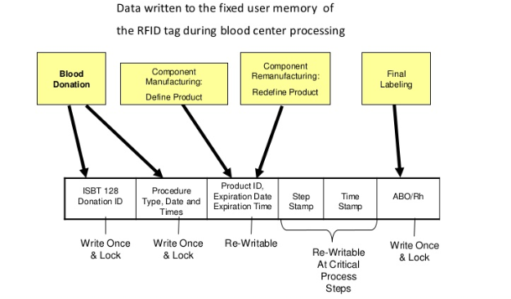
Proposed Solution
Apply RFID Barcode Printed Label on each Blood pouch after testing of each pouch before storing.
RFID USB Desktop reader for TAG registration and Distribution.
Picking of Blood packet from rack and RFID tag reading using FIFO method
Cross checking of registration Barcode data and distributed Blood pouch rfid tag data & software warning message will appear if any mismatch found
Portable scanner searching option for correct Blood packet as per requisition & inventory

Slide 8
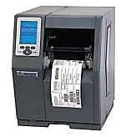
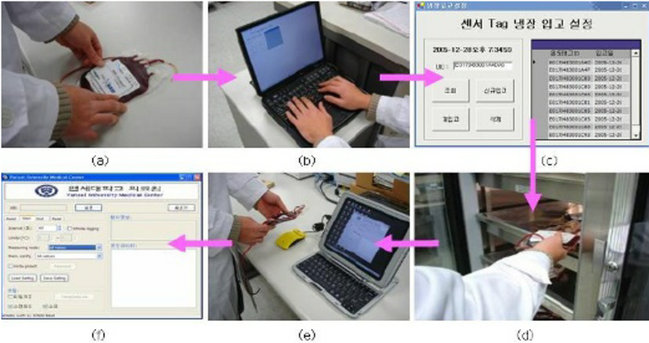
Tag Registration & store in & out
Tag Registration & Printing
Registered Tag Affixed On Blood Packet

Slide 9
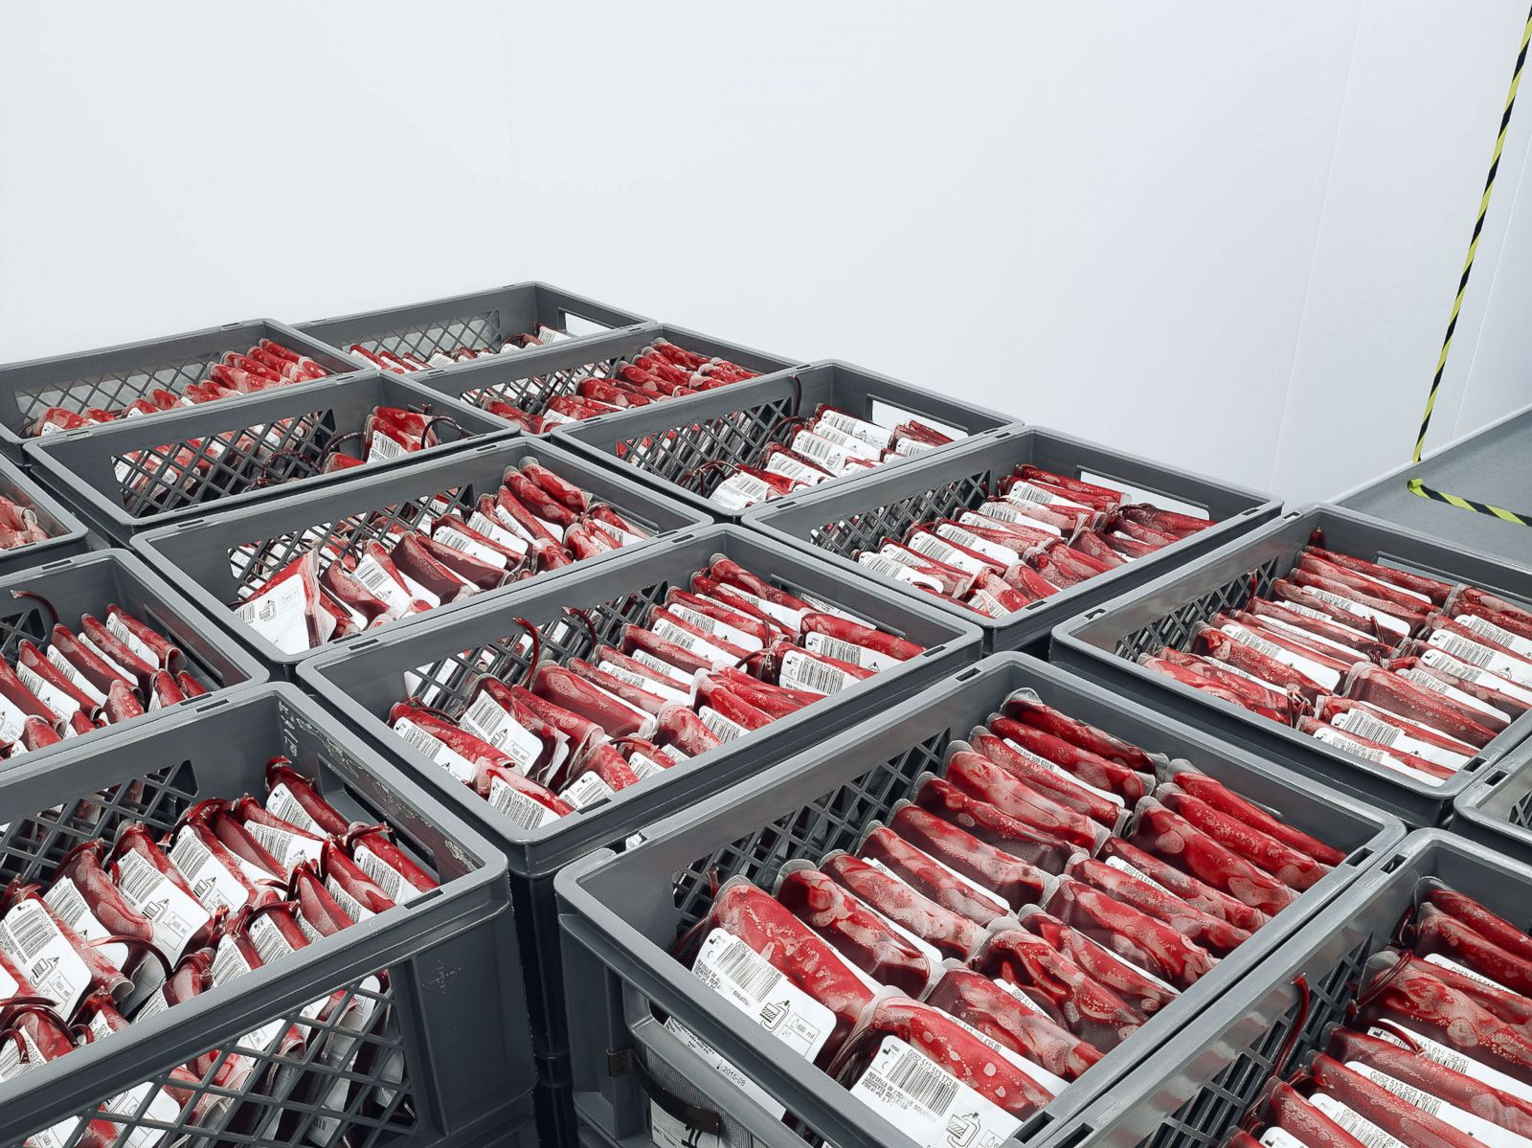
Benefits of RFID Tracking
Increases asset visibility
Eliminates any delay in product deliveries
Mitigates loss or wastage and risk
Reduces labour costs and increases productivity
Quick, Precise Identification for Inventory
Live Accurate Database
Faster Distribution

Slide 10
Thanks You
THANK Y
For your wathcing

